Slide 1
Online Ticket Reservation System
A Web Based Software Engineering Project
PRESENTED BY
Deepika- 23BCY1O185
Paree Khatri- 23BCY10194
Shreya Prakash-23 BCY10243
Geetanjali Singh- 23BCY10238
Divyanshi Chouhan-23BCY10152

Slide 2
Index
S.NO | TABLE OF CONTENT
1. | Introduction
2. | Project Objectives
3. | Literature Review
4. | Problem Statement
5. | Methodology
6. | Proposed Method
7. | Workflow of the project
8. | Source Code
9. | Results & Discussion
10. | Conclusion

Slide 3
Team members Work distribution
S.NO | TEAM MEMBERS | REGISTRATION NUMBER | WORK DISTRIBUTION
1. | Deepika | 23BCY10185 | Software
2. | Paree Khatri | 23BCY10194 | SRS Document
3. | Shreya Prakash | 23BCY10243 | SRS Document
4. | Geetanjali Singh | 23BCY10238 | PPT
5. | Divyanshi Chouhan | 23BCY10152 | PPT

Slide 4
Introduction
The Online Ticket Reservation System is designed to automate and simplify the booking process through a secure, efficient, and user-friendly platform. Unlike traditional manual reservations, which are time-consuming and error-prone, this system provides customers with 24/7 access to real-time ticket availability, booking, cancellation, and online payment facilities.
Its main purpose is to enhance convenience for customers while reducing administrative workload. By offering instant e-tickets, transparent transactions, and faster services, the system improves the overall experience for both users and service providers.

Slide 5
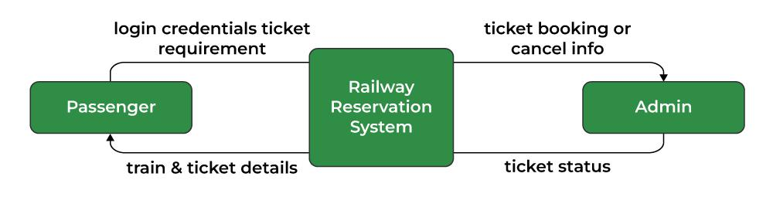
Example - online railway ticket booking system
Context Diagram

Slide 6
The system provides a centralized solution for both customers and administrators.
Customers can search routes, reserve seats, make secure payments, and manage cancellations.
Administrators can manage schedules, ticket inventory, pricing, and generate reports for revenue monitoring.
This ensures real-time updates, reduced dependency on manual staff, and accurate handling of reservations. The scope of the system covers all major aspects of ticket management, making the process more efficient and reliable.
The Online Ticket Reservation System delivers benefits such as:-
Customer Side: Convenience, transparency, time savings, and 24/7 access.
Administration Side: Reduced manual effort, better management, and accurate reporting.
In conclusion, it acts as a robust, scalable, and reliable platform that enhances the ticketing process by making it simpler, faster, and more efficient. This sets the stage for the detailed SRS document that follows.

Slide 7
Project Objectives
The objectives of the Online Ticket Reservation System are:
Provide a User-Friendly Platform – Ensure customers can easily search, book, and manage tickets through a simple and intuitive interface.
Enable Real-Time Booking – Offer instant ticket availability, seat selection, and confirmation without delays.
Ensure Secure Transactions – Integrate a reliable and secure payment gateway to handle online payments safely.
Support Ticket Management – Allow users to cancel or modify reservations and receive timely refunds or updates.

Slide 8
Reduce Manual Workload – Automate booking, scheduling, and reporting processes to minimize human effort and errors.
Improve Administrative Control – Provide admins with tools to manage routes, schedules, pricing, and monitor sales and revenue.
Generate Reports – Deliver statistical and financial reports for better decision-making and business insights.
Scalability & Reliability – Design the system to handle growing user demand efficiently and maintain high availability.

Slide 9
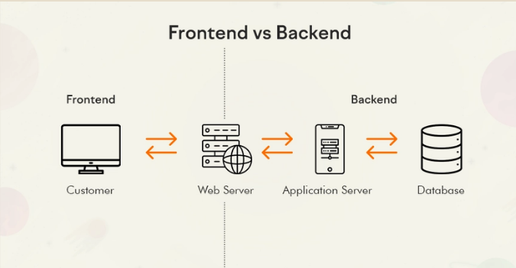
Technology Stack Diagram

Slide 10
Literature Review
Overview
Online ticket reservation systems have evolved from simple catalogue-and-book interfaces to complex, distributed platforms that handle high concurrency, secure payments, dynamic pricing, and multi-channel access (web + mobile). The literature spans applied engineering (system architectures, database design, caching, and load balancing), human-computer interaction (usability and accessibility), and security (payment protection, data privacy, fraud detection). Research and industry reports consistently emphasize transaction consistency, low-latency seat allocation, and fault tolerance as the core technical challenges..

Slide 11
Key themes from prior work
Concurrency & Consistency: Many studies focus on algorithms and patterns to prevent double-booking (optimistic vs pessimistic locking, seat-hold strategies, transactional queues, and distributed locks). Solutions commonly combine short “holds” with background cleanup and eventual consistency for high throughput systems.
Scalability & Performance: Architectures using horizontal scaling, stateless application servers, in-memory caches (Redis/Memcached), and database sharding are frequent recommendations. Message queues and worker pools are used to decouple booking flows (reserve → pay → confirm) to improve resilience.
Payment & Security: Research stresses PCI-DSS compliance, tokenization of card data, secure integration with third-party gateways, and layered defenses against replay or tampering attacks. Authentication best practices (multi-factor, session management, rate limiting) and GDPR-style privacy management are also highlighted.

Slide 12
Usability & UX: Papers comparing manual vs. online booking emphasize simple flows, clear seat/price visualization, and reduced cognitive load (progressive disclosure, confirmations, and error recovery). Accessibility (WCAG), localization, and mobile UX are recurring concerns for adoption.
Business Features & Data Analytics: Work on dynamic pricing, recommendation engines, and demand forecasting shows how analytics can increase revenue. Admin modules for reporting, audit trails, and anomaly detection are advised for operational control

Slide 13
Comparative systems & case studies:-
Existing commercial and open-source systems illustrate a range of tradeoffs: systems focused on high volume (airlines, large events) favor eventual consistency plus robust reconciliation; smaller-scale ticketing emphasizes simplicity and cost-effectiveness. Case studies often report that poor seat-locking logic or slow payment integration are the most common causes of user dissatisfaction and revenue loss.
Identified gaps & opportunities
Many implementations compromise strict consistency for performance without a clear reconciliation strategy—this creates edge-case failures (duplicate allocations, ghost seats).
Usability research shows a gap between academic UX recommendations and real deployments, especially around failure-handling (payment timeouts, partial confirmations).
Limited literature addresses modular, low-cost architectures suitable for small-to-medium operators that still achieve high reliability.
These gaps motivate a design that provides robust seat management, clear user feedback on transaction state, and modular components that can scale as demand grows.

Slide 14
Relevance to this project
This project will adopt proven patterns: short-duration seat holds, atomic confirmation after payment, stateless front-end servers, caching for read-heavy queries, and secure payment gateway integration. It will also prioritize clear UX for error and timeout cases, and include admin reporting to aid reconciliation—directly addressing several gaps identified in the literature.

Slide 15
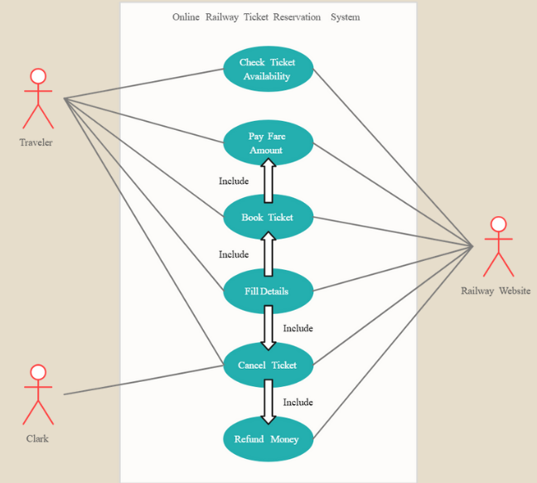
Example - online railway ticket booking system
Use Case Diagram

Slide 16
Problem Statement
In the traditional ticket reservation process, customers are required to visit physical counters or depend on third-party agents, which is time-consuming, inefficient, and prone to errors. Manual booking systems often lead to issues such as duplicate reservations, lack of transparency in seat availability, delayed confirmations, and difficulties in cancellations or refunds.
With the growing demand for fast, reliable, and user-friendly services, the absence of a centralized and automated platform creates inconvenience for customers and increases the workload on administration. Additionally, managing large volumes of reservations manually results in poor scalability, revenue loss, and reduced customer satisfaction.
Therefore, there is a need for an Online Ticket Reservation System that can automate the booking process, provide real-time availability and secure payment options, and improve overall efficiency for both customers and administrators

Slide 17
Methodology (Step-by-Step)
The development of the Online Ticket Reservation System follows a structured methodology to ensure efficiency, accuracy, and scalability. The process can be divided into the following stages:
1. Requirement Analysis
Gather functional and non-functional requirements from stakeholders.
Identify user needs: booking, cancellation, payment, and administration.
Define constraints such as security, performance, and scalability.
2. System Design
Create use case diagrams, data flow diagrams, and database schema.
Define architecture (client–server, centralized database, payment integration).
Design user-friendly interfaces for customers and admin modules.

Slide 18
3. Implementation
Develop front-end using suitable technologies (e.g., Java, HTML/CSS, Swing).
Implement back-end with database support (MySQL/Oracle) for seat allocation and transaction management.
Integrate secure payment gateway and authentication modules.
4. Testing
Conduct unit testing for individual modules.
Perform integration testing for booking → payment → confirmation flow.
Carry out user acceptance testing (UAT) to ensure system reliability.
5. Deployment & Maintenance
Deploy the system on a secure server or cloud platform.
Provide training and documentation for end-users.
Continuously monitor, update, and maintain the system for improvements.

Slide 19
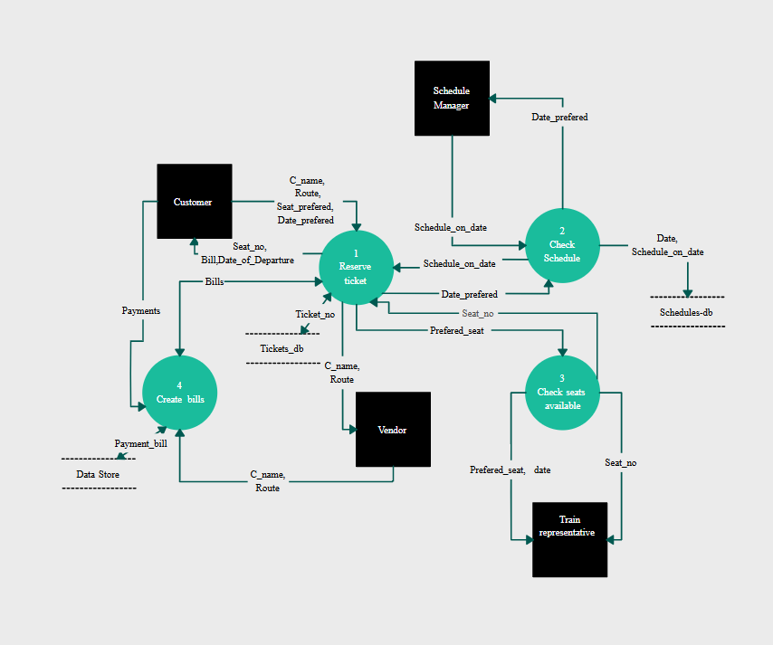
Example – Online Railway Ticket Reservation System
Data Flow Diagram

Slide 20
Proposed Method
The proposed Online Ticket Reservation System provides a centralized, automated, and user-friendly platform to overcome the limitations of manual booking. The method focuses on real-time ticket availability, secure payments, and efficient management.
Key Features of the Proposed Method
Centralized Database: All booking, cancellation, and schedule data stored in a unified system to avoid duplication and inconsistency.
Real-Time Availability: Customers can instantly view and select available seats.
Automated Booking Workflow: Search → Select Ticket → Payment → Confirmation → E-Ticket generation.
Secure Transactions: Integration of a payment gateway with encryption to ensure safe online payments.

Slide 21
User Roles:
  Customer Module – Ticket booking, cancellation, payment, and e-ticket access.
  Admin Module – Manage schedules, prices, ticket inventory, and generate reports.
Scalability & Accessibility: Designed for 24/7 online access and able to handle growing user demand.
Error Handling: Proper notifications for failed payments, booking errors, or seat unavailability.
Advantages of the Proposed Method
Eliminates delays and errors in manual booking.
Provides transparency and convenience to customers.
Reduces administrative workload with automated processes.
Enhances business efficiency through reporting and monitoring tools.

Slide 22
Workflow of the Project
Step 1: User Registration & Login
New users register with personal details.
Existing users log in with credentials.
Step 2: Search for Tickets
User enters journey details (source, destination, date, category).
System displays available schedules and seat availability.
Step 3: Ticket Selection
User selects preferred schedule and seats.
System temporarily holds the seat to avoid duplication

Slide 23
Step 4: Payment & Confirmation
User proceeds to secure payment gateway.
On successful payment, booking is confirmed.
An e-ticket is generated and sent to the user via email/SMS.
Step 5: Cancellation/Refund (Optional)
User may cancel tickets before journey.
System processes refund as per policy.
Step 6: Admin Operations
Admin manages schedules, routes, pricing, and ticket inventory.
Admin generates reports on bookings, cancellations, and revenue.

Slide 24
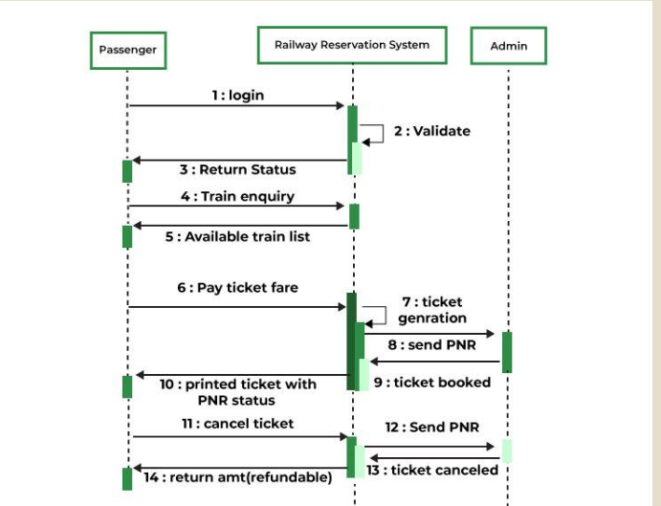
Example – Online Railway Ticket Reservation System
Sequence Diagram

Slide 25
Results & Discussion
Results
The Online Ticket Reservation System successfully achieves the following outcomes:
User Registration & Login: Secure and role-based access for customers and administrators.
Ticket Booking: Real-time availability check, seat selection, and instant confirmation.
Payment Integration: Smooth and secure payment processing with automatic e-ticket generation.
Cancellation/Refund: Flexible ticket cancellation with automated refund mechanism.
Admin Dashboard: Tools to manage schedules, pricing, and ticket inventory effectively.
Reporting Module: Statistical and financial reports for monitoring sales and performance.

Slide 26
Results & Discussion
Discussion
The system improves efficiency by automating booking and reducing manual work.
It ensures transparency and convenience for customers through 24/7 accessibility.
Data consistency and reliability are maintained via a centralized database.
The solution is scalable, handling multiple concurrent users without errors like double booking.
Challenges include the need for continuous system maintenance, secure handling of sensitive data, and dependence on internet connectivity.
Overall, the system provides a robust, user-friendly, and reliable platform that enhances customer satisfaction and business operations compared to traditional manual reservation methods.

Slide 27
Conclusion
The Online Ticket Reservation System provides a comprehensive, reliable, and efficient solution for automating the process of ticket booking. By replacing the traditional manual system, it ensures real-time availability, secure transactions, and convenient access for customers while significantly reducing administrative workload.
The system enhances customer satisfaction by offering transparency, 24/7 accessibility, and instant e-ticket generation. For administrators, it delivers better control through schedule management, revenue tracking, and reporting tools.
Although challenges such as data security, internet dependency, and system maintenance must be addressed, the project demonstrates that an online reservation system can serve as a robust, scalable, and user-friendly platform. It not only streamlines operations but also supports the growing demand for digital transformation in ticketing services.

Slide 28
THANK YOU

